Slide 1
A6441 – Internship - I
VARDHAMAN COLLEGE OF ENGINEERING, HYDERABAD
Autonomous institute, affiliated to JNTUH
EMBEDDED AI DESIGN
@ DIGITOAD TECHNOLOGIES, AB Square 617, 5th Main OMBR Layout
BENGALURU, KARNATAKA
By
20881A04M8 – L. Naga Sai Gayathri Priya
Under the guidance of
Mr.R. Phani Vidyadhar
Assistant Professor, Dept. of ECE

Slide 2
Embedded AI Design
Certificate of Internship:

Slide 3
Embedded AI Design
Outline:
Objectives
History
Introduction
Architecture/Block Diagrams
Methodology adapted in objectives achieved
Skills learned during the internship
Results/observations/work experiences
Applications
Conclusions
References

Slide 4
Embedded AI Design
Objectives:
Installation of Embedded AI development tool chain.
Hands on Labs using STM32 GPIO- on board LED and Button.
Introduction to Sensor Technology.
Detection and identification of different audio signals.
Detection and identification of different vibrations and motions using sensors.

Slide 5
Embedded AI Design
History:
The Embedded AI Design is started in order to have highly optimized, low footprint machine learning algorithms that run on ultralow power microcontrollers.
The microcontroller which is used is STM32 microcontroller.
The STM32 is the third ARM family by STMicroelectronics.
This approach is particularly useful in ‘always-on’ applications where power consumption needs to be minimized and invasion of privacy is a serious concern.
These Embedded AI Design technologies are used for having a low power consumption products.

Slide 6
Embedded AI Design
Introduction:
Artificial intelligence (AI) is being incorporated into small, low-power embedded computing devices for consumer electronics, industry, and the Internet of Things (IoT).
Embedded artificial intelligence (AI) is the application of machine and deep learning in software at the device level. Software can be programmed to provide both predictive and reactive intelligence, based on the data that is collected and analyzed.
STM32 is a family of 32-bit microcontroller integrated circuits by STMicroelectronics.
GPIO stands for general purpose input/output. It is a type of pin found on an integrated circuit that does not have a specific function. the function of a GPIO pin is customizable and can be controlled by the software.
In STM32 GPIO is used as input configuration such as to enable the clock.

Slide 7
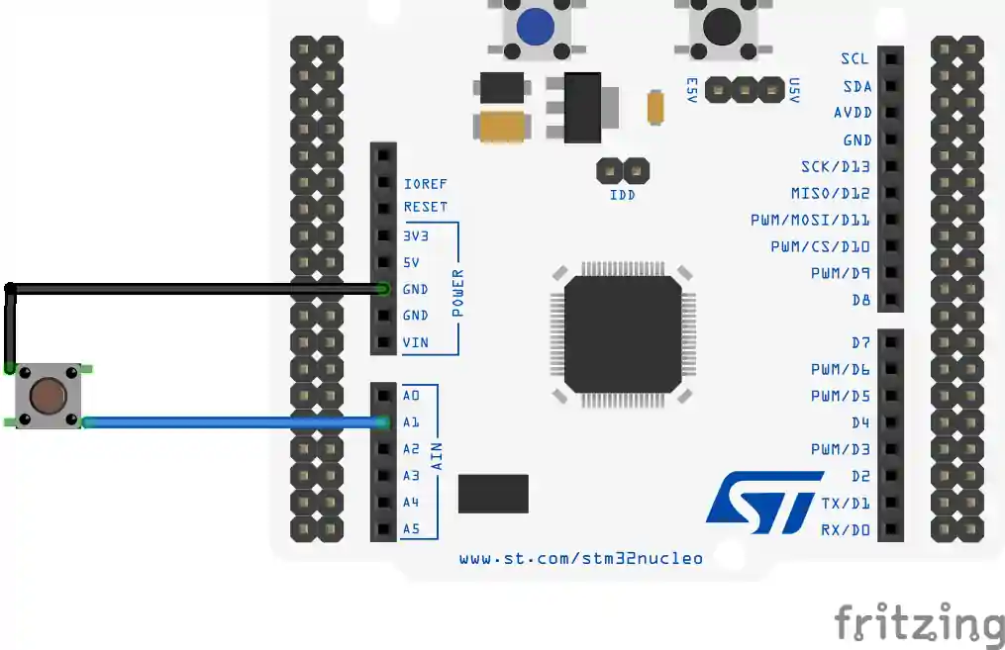
Embedded AI Design
Architecture/Block Diagrams:
STM32 MICROCONTROLLER
https://controllerstech.com/wp-content/uploads/2020/12/gpioinput2.webp

Slide 8
Embedded AI Design
Methodology adapted in objectives achieved:
To start with Embedded AI design, installation of Embedded AI development tool chain is mandatory.
In this the main tool for designing is NanoEdge AI Studio and the programming part requires Arduino 1.8.19
The codes required for the hardware interfaces are taken from different url’s mentioned by the instructor like:
shorturl.at/fmvJO- where codes for LED interfacing are
available.
Different libraries are also included in the Arduino which are required for the interfacing and hardware purposes.

Slide 9
Embedded AI Design
Methodology adapted in objectives achieved:
ARDUINO : While using Arduino we have to set the required board (nucleo-64), board part number and port.
NANOEDGE AI STUDIO : For converting an analog signal to digital signal or for any audio signal transmissions the following steps has to be done:
N-class classification
Project settings
Signals
Benchmark
Emulator
Validation
Deployment

Slide 10
Embedded AI Design
Skills learned during the internship :
Installation of the tools required for the Embedded AI Design like NanoEdge AI Studio and Arduino.
Working with Arduino for hardware implementation like blinking and button of LED and serial communication.
Interfacing hardware using NanoEdge AI Studio.
Different audio signals can be detected and identified using the tool.
Analog signals are transmitted using the software and samples are generated.
Different vibrations and motions signals can be detected using sensors.

Slide 11
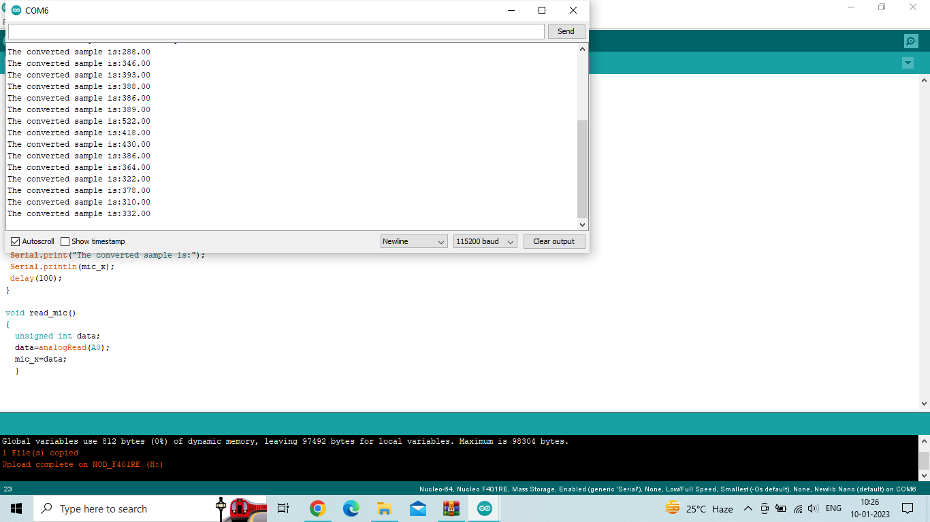
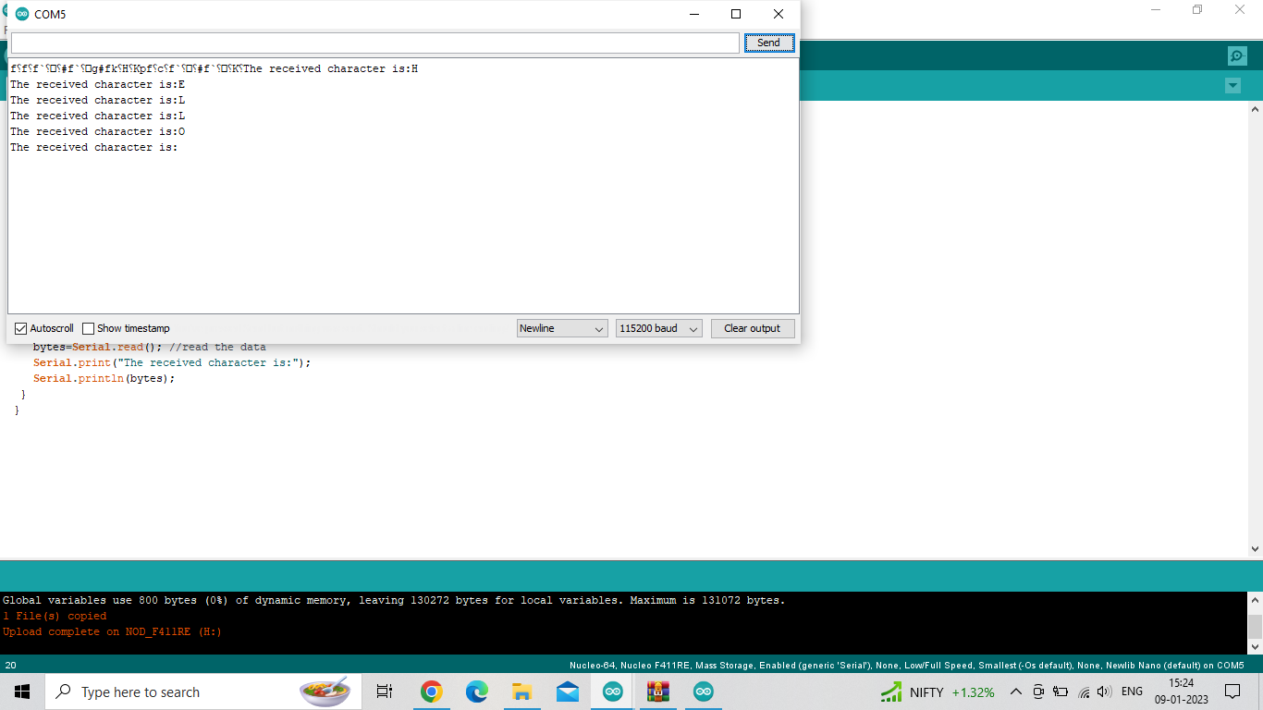
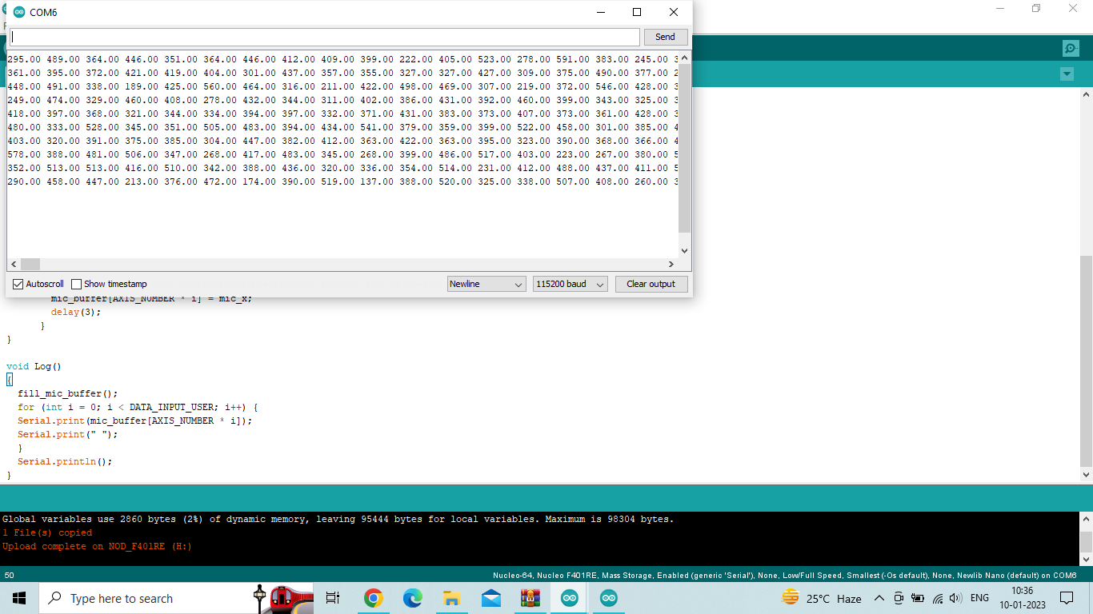
Embedded AI Design
Results/observations/work experiences:
Serial Communication
Samples for an Analog signal

Slide 12
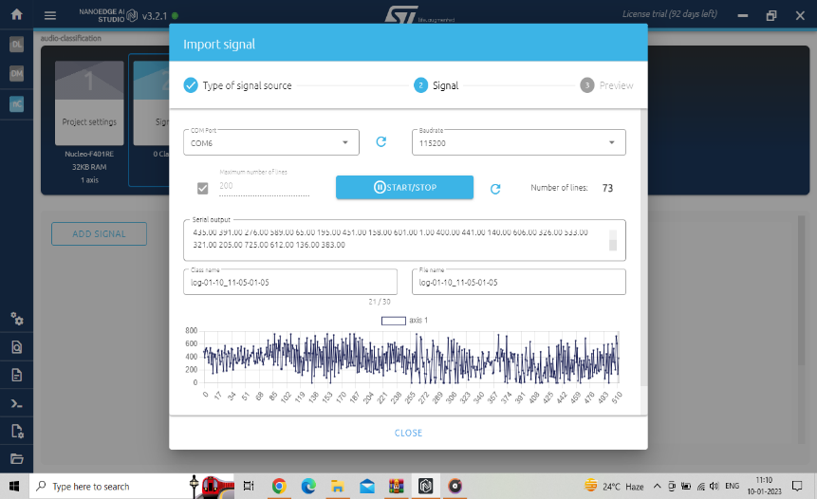
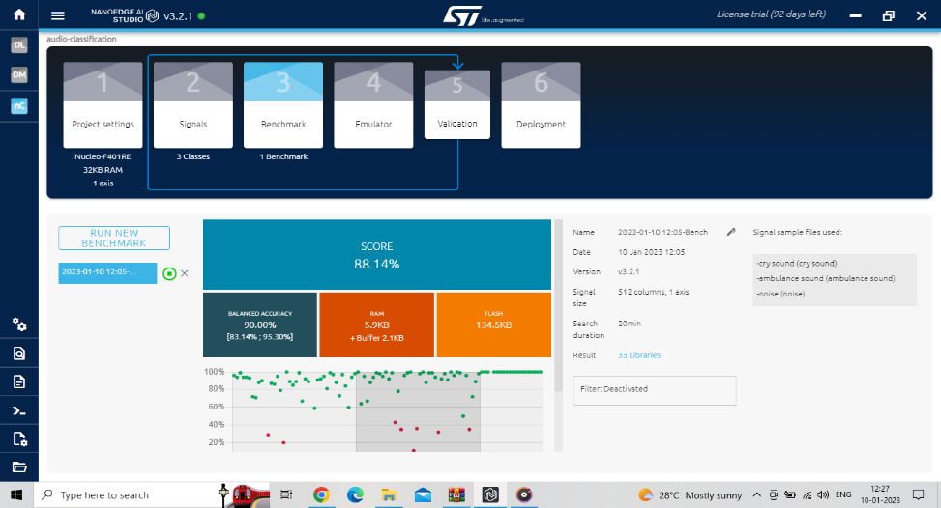
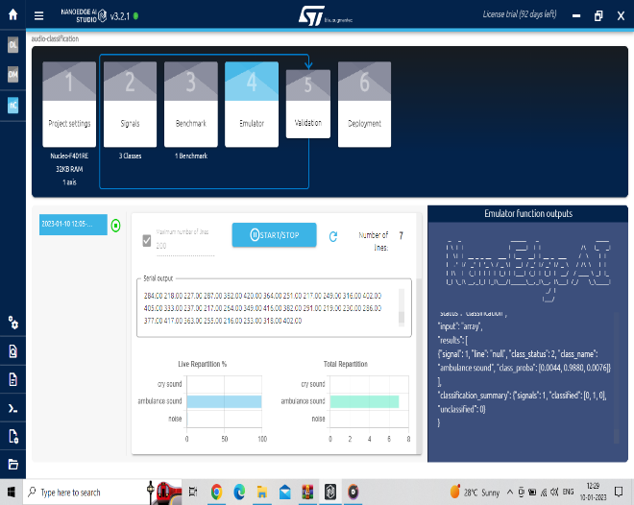
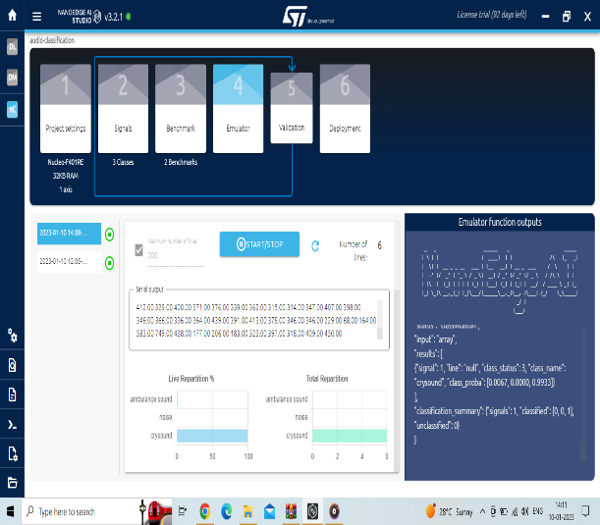
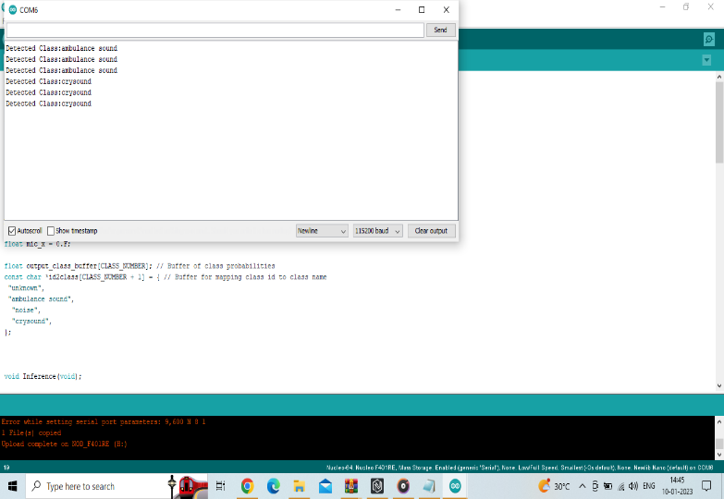
Embedded AI Design
Collecting the signals
Benchmark of the signals
Detecting the sounds
Output of sound detection in
the Arduino

Slide 13
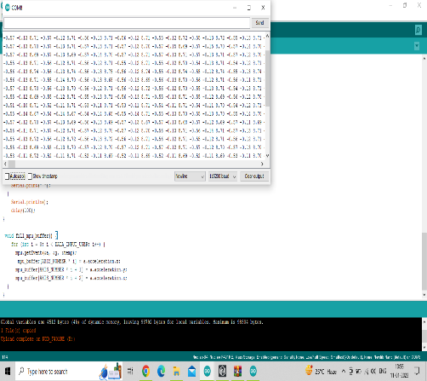
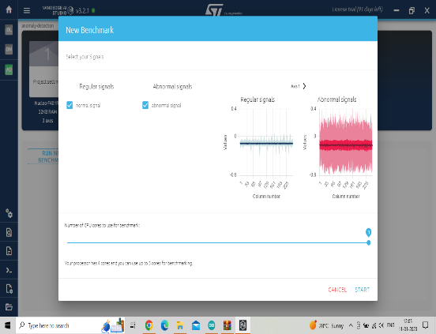
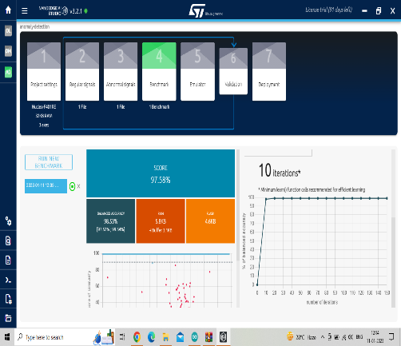
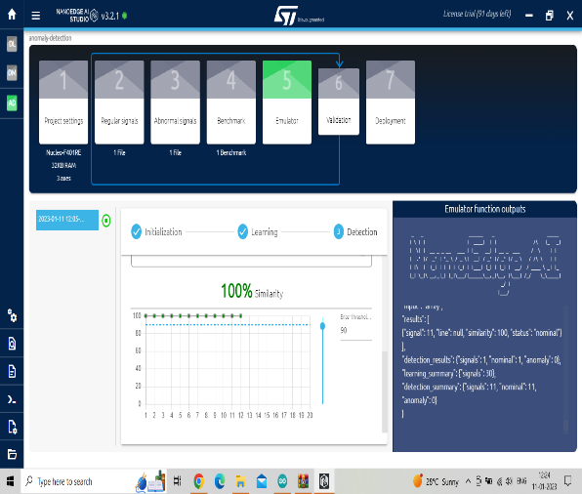

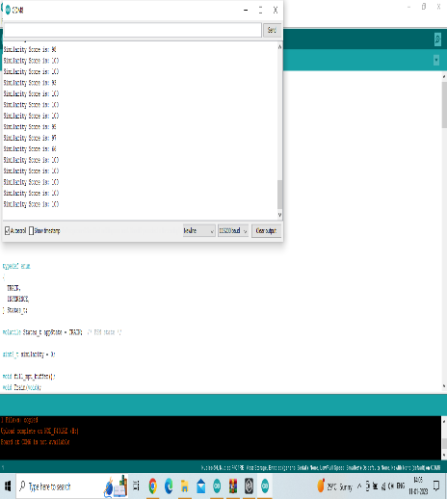
Embedded AI Design
Vibration data generated samples
Generated signals
Benchmark score
Emulator with similarity
Emulator with dissimilarity
Output in Serial Monitor

Slide 14



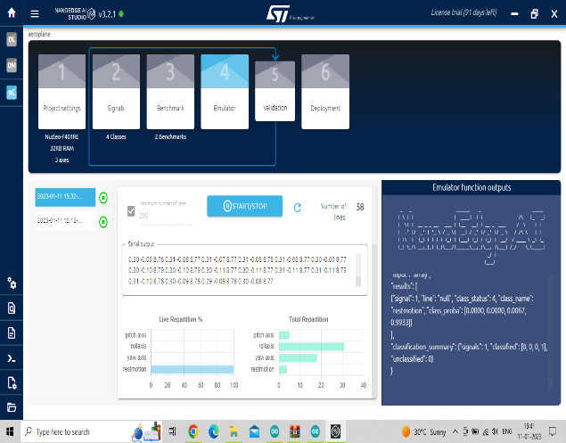
Embedded AI Design
Emulator of Pitch Axis
Roll Axis Emulation
Yaw Axis Emulation
Rest Motion Emulation

Slide 15
Embedded AI Design
Applications:
Analog/digital design using discrete components.
Designing PCB with micro-controllers, wireless interfaces, energy harvesting and sensors and test on the field.
Firmware implementation for low power and application.
High-level software programming, machine learning, wireless communication.
Used for LCD’s.
Different audio signals can be detected and identified.
Different vibrations and motion signals can be identified and detected using sensors.

Slide 16
Embedded AI Design
Conclusions:
Embedded AI Design is performed using tools like NanoEdge AI Studio and Arduino.
Interfacing using Arduino, STM32 and NanoEdge AI Studio is achieved.
Different audio signals are detected and identified using the tool.
Different vibrations and motion signals can be identified and detected using sensors.

Slide 17
Embedded AI Design
References:
[1]. Andrew N. Sloss, Dominic Symes and Chris Wright (2008), ARM Systems Developer’s Guides - Designing & Optimizing System software, Elsevier, New Delhi, India.
[2]. Mohamad Hazwan Mohd Ghazali and Wan Rahiman , Vibration Analysis for Machine Monitoring. [3]. Sara Anastasia , Marianna Madonnab , Luigi Monicaa, Implications of Embedded Artifical Intelligence.

Slide 18
Embedded AI Design
Any Questions/Discussions ???

Slide 19
Embedded AI Design
Thank You !!!

